Slide 1
Predicting the Nenana Ice Classic
Julian Benitez Mages, Aidan Johansson, Garrin Shieh, Michael Lembck
Notes:
I’d like to start by quickly asking if anyone knows about it

Slide 2
Background Information

Slide 3
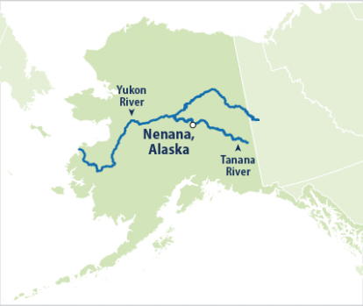
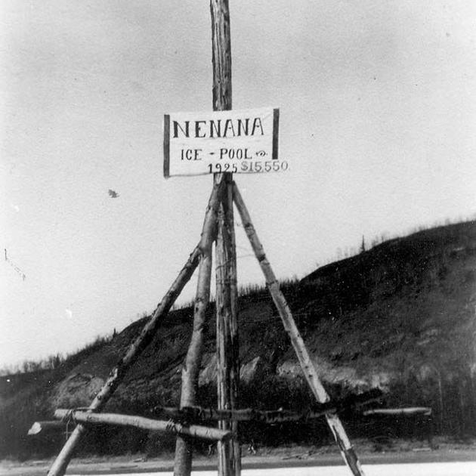
Background Information
What?
Where?
When?
Who?
Why?
Notes:
The Nenana Ice Classic takes place on the Tanana River in Alaska, where bettors place bets on the exact date and time that the river ice will break each Spring.
Every year since 1917, people across Alaska and later across America have participated for $2.50 a guess.
In the 2021 contest, the jackpot was split amongst 12 people who guessed correctly, with each taking home around 20 thousand dollars ($19,465.92. )

Slide 4
Dataset Information
Datasets:
Ice Breakup Dates
Daily Temperature / Precipitation in Nenana
Monthly Temperature / Precipitation in Nenana
Daily Temperature / Precipitation in Fairbanks
Daily Wind Speed and Direction in Nenana
Ice Thickness
Notes:
The first major process will be tidying and organizing the dataset to build the model. We would like to have each row of the final dataframe to represent one year, with the breakup time and all the possible predictor values for that year. We would like predictor values to consist of weather data such as average temperatures and snow depth, aggregated across months, weeks, or the entire winter. Another predictor we can use is the ice thickness, which is recorded on certain days throughout the winter and gives a clear idea as to when the ice may break. (talk about source of datasets - weather stations and airports)

Slide 5
Initial Tidying + Organizing
1 row = 1 year
Breakup Time and Possible Predictor Values
Average Temperatures
Snow Depth
Ice Thickness
Notes:
Julian
The first major process will be tidying and organizing the dataset to build the model. We would like to have each row of the final dataframe to represent one year, with the breakup time and all the possible predictor values for that year. We would like predictor values to consist of weather data such as average temperatures and snow depth, aggregated across months, weeks, or the entire winter. Another predictor we can use is the ice thickness, which is recorded on certain days throughout the winter and gives a clear idea as to when the ice may break.

Slide 6
Data Issues & Our Methods

Slide 7
Dataset Issues
Incomplete Data
Min/Max Temperature there since 1917
Snowfall, Wind Speed, Ice Thickness only since 1980s
Comparably Few Rows (~100)
Costly Alternatives
Information by Calendar Year Isn’t Ideal
Notes:
Aidan
There will be many potential challenges and hurdles for this project. One main issue is that our datasets don’t have complete data for many predictors, as the weather stations weren’t able to measure such statistics 100 years ago. We will either have to only focus on years where all the predictors are present or use all the years’ worth of data in which not all predictors are indicated. For example, data on the minimum and maximum temperature are consistent since 1917, but some of the values such as snowfall and wind speed have only been around for the Nenana Weather Station since the 1980s. This also applies to the ice thickness metric, which only started being reported by the contest organizers in 1989.
It’s also the case that the ice usually breaks around April or May, so using the entire calendar year seemed to us an ineffective way to measure variables for a given year. For example, if the ice breaks in April of a given year, it seems nonsensical to use the average rainfall in October of that same year as a predictor for an event that happened several months prior.

Slide 8
Our Solution
Use another weather station
Located 55 miles away in the neighboring city (Fairbanks, AK)
Much more complete data
Stagger Values for June - December
Notes:
Aidan
Another method we found to fix this issue of missing data is to use another weather station located in Fairbanks Alaska to supplement our missing data. It is the next best option as it is a large neighboring city only 55 miles away (quite close for Alaskan standards), and has much more complete historical data due to it being a much larger town. In total, we have two datasets, one from Nenana and one from Fairbanks which we will combine to ensure we get the most complete picture of the data.
To solve the issue of the calendar year, we decided that for a given year, the values within December to May will be of that same year, and the values for June to December will be those of the year prior. This ensures that for the most part, all the variables used with a given year are from the 12 months leading up to when the ice breaks.

Slide 9
Models
Linear Regression
Stepwise Model Selection
K-fold Cross-Validation
Principal Component Analysis
K-means Clustering
Notes:
Aidan
To create our final predictive model, we will be using five methods discussed in class in order to find the best model possible: Linear Regression, Stepwise Model Selection, K-fold Cross-Validation, Principal Component Analysis, and K-means Clustering

Slide 10
Results
Notes:
Garrin

Slide 11
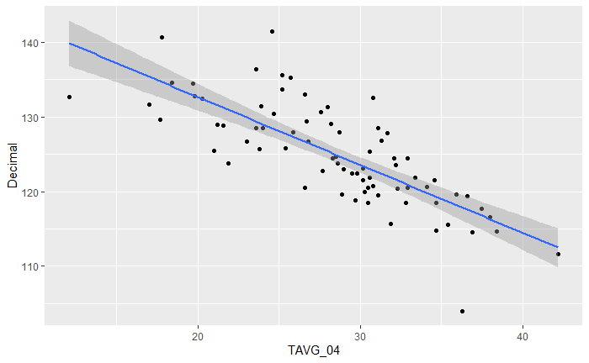
Exploratory Linear Regression Model
Image of it
Example: Average Temperature in April and Day of Year
Notes:
Garrin
To see how viable our project is, we plotted our response variable against a multitude of potential predictors. Here, we have the response variable (day of year) against the average daily temperature of April. We chose April because the ice usually cracks around mid April to mid May. As seen, there is a pretty linear correlation between these two. As average temperature increases, the ice breakup day becomes earlier. This makes intuitive sense.

Slide 12
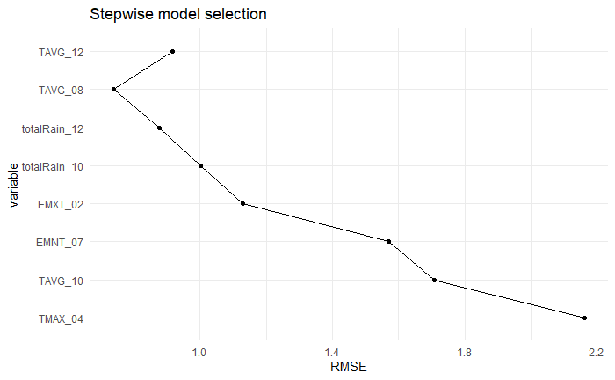
Stepwise Model Selection
Results:
RMSE decreased significantly as we added more predictors until it tapered off
Final model has 6 predictors, RMSE around 0.75
Removed one predictor due to low statistical significance
Thought process:
60-20-20 Partitioned Dataset
Forward Process
Used normal (no log) scale due to large amounts of negative data (temperature)
Image of it
Notes:
Garrin
Here is the process we took to see which candidate predictors matter and which ones don’t. We used a forward process, meaning we started with no candidate predictors and we added each one by one based on which candidate had the lowest RMSE. To ensure our model is accurate, we partitioned our data in a 60-20-20 split, meaning that 60% of the data was used to train and 20% was used to validate and test. We opted to do this over a 50-25-25 split since our dataset only has around 100 rows (one for each year). As expected when going through stepwise model selection, the RMSE decreased significantly as the first predictors were added, but tapered off after a few. Once there was little to no improvement in RMSE, we decided to take the first 7 predictors for our model. Since one predictor, the total rain in December, has an extremely high P-value of 0.96, we decided to remove it from our final model. Our final model has (bear with me here) the average max temperature of April, average temperature in October, absolute minimum temperature of July, absolute maximum temperature of February, total rain of October, and average daily temperature of August.
Overall I’m a bit surprised by these results, considering a lot of the predictors that affected the RMSE the most were in months in other seasons.

Slide 13
K-Fold Cross-Validation
5 folds since dataset only has 100 rows
RMSE data:
Min: 3.032
Mean: 4.188
Median: 4.210
Max: 5.245

Slide 14
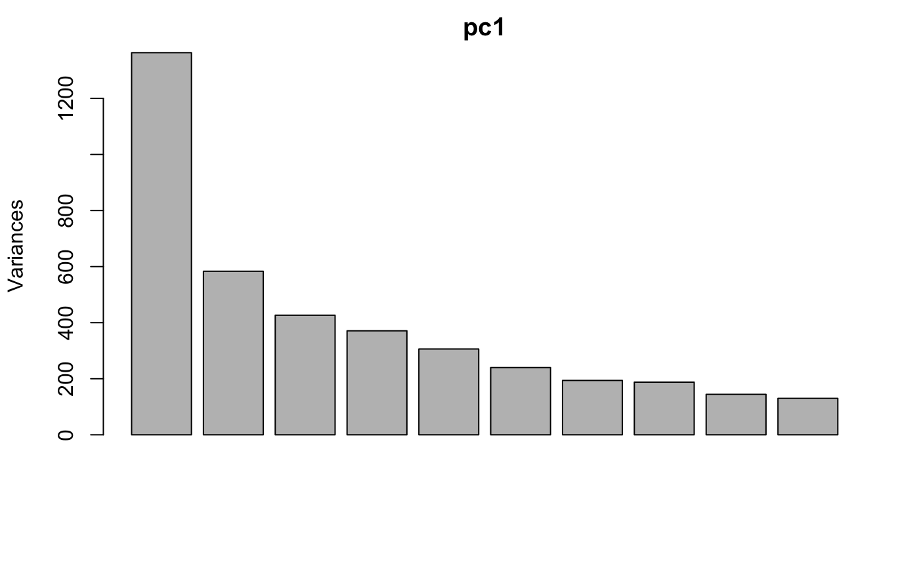
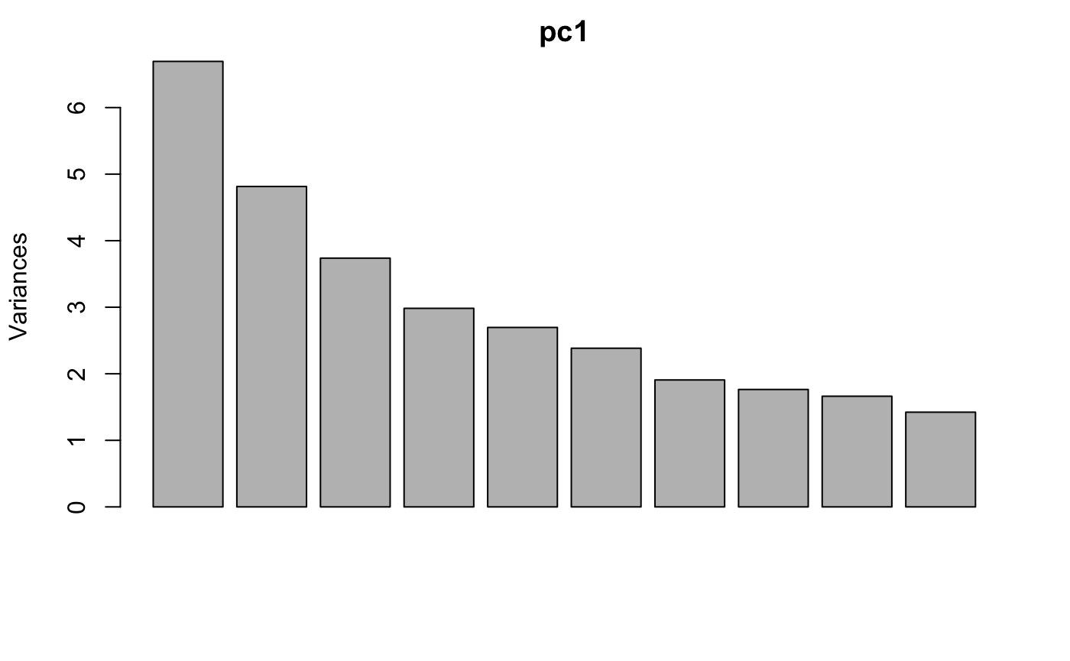
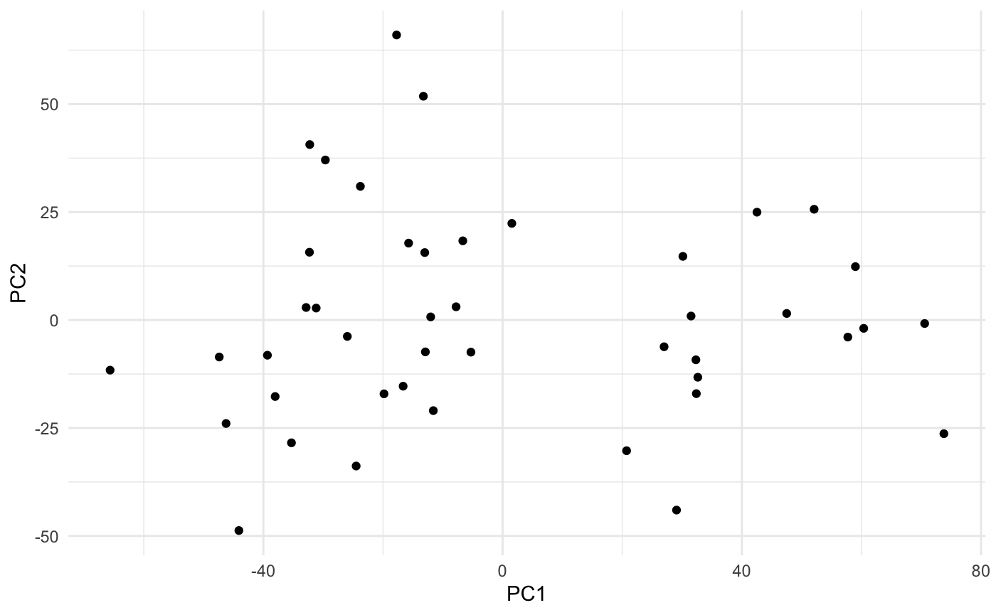
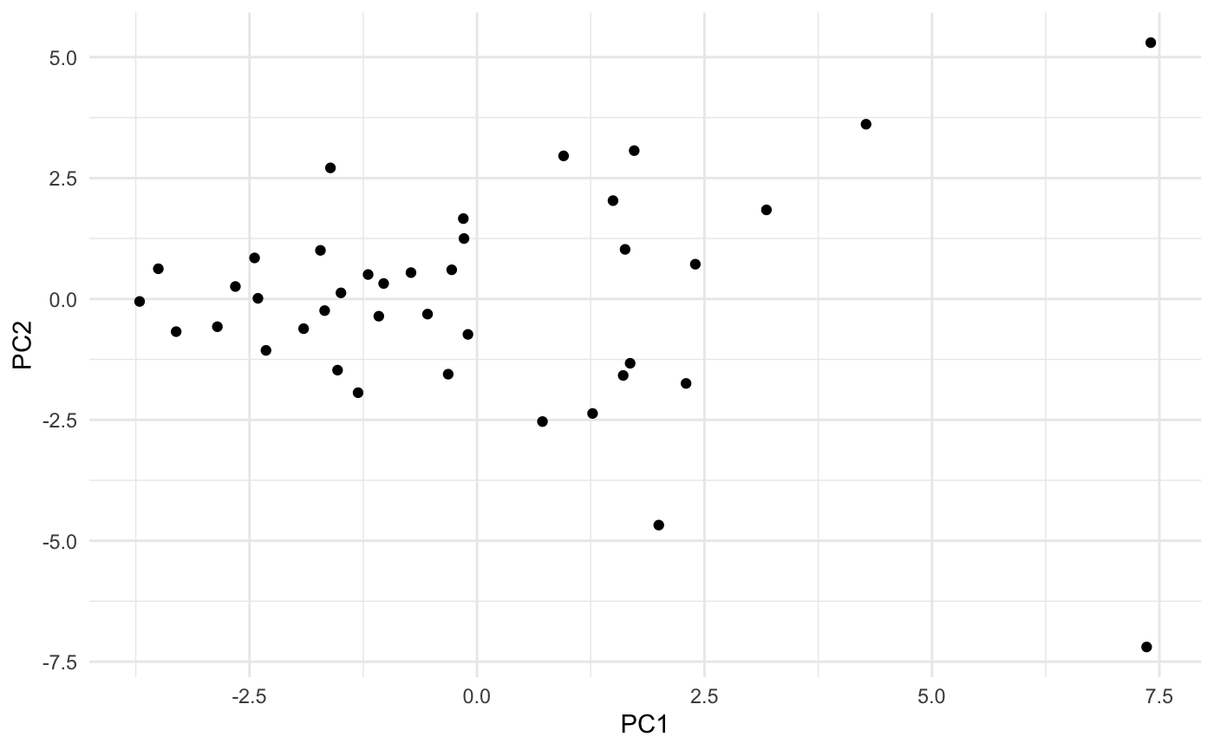
Principal Component Analysis
Without wind
Multiple Principal Components
40% covered by first two
80% covered by first ten
With wind
One Principal Components
50% covered by first four
90% covered by first ten
Notes:
Alright now let’s get into the principal component analysis that we ran for dimension reduction. Dimension reduction is used to transform a dataset with a bunch of attributes into one with much less. This increases efficiency for models but can take away from the understandability of each attribute as most likely its a combination of many of the original attributes. The classic approach to dimension reduction is principal component analysis. We conducted two of them, one including wind data and the other without. It was interesting to see how the proportion of variance covered by the principal components varies between the two datasets. Without the wind there was one clear component that stood out, capturing around 30% of the variance while taking into account. On the other hand the data with wind included there isn’t one that truly sticks out.

Slide 15
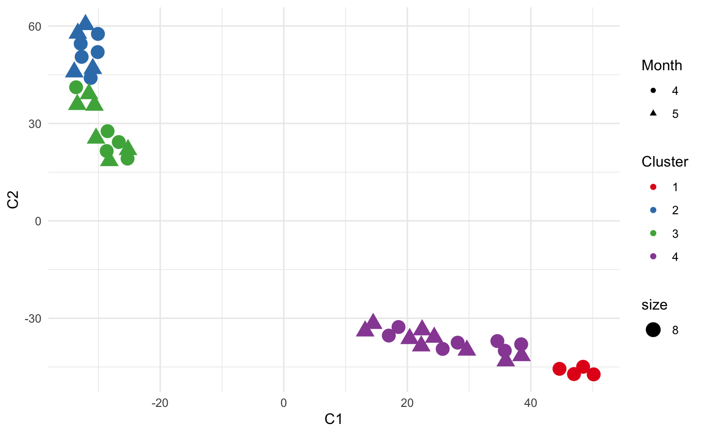
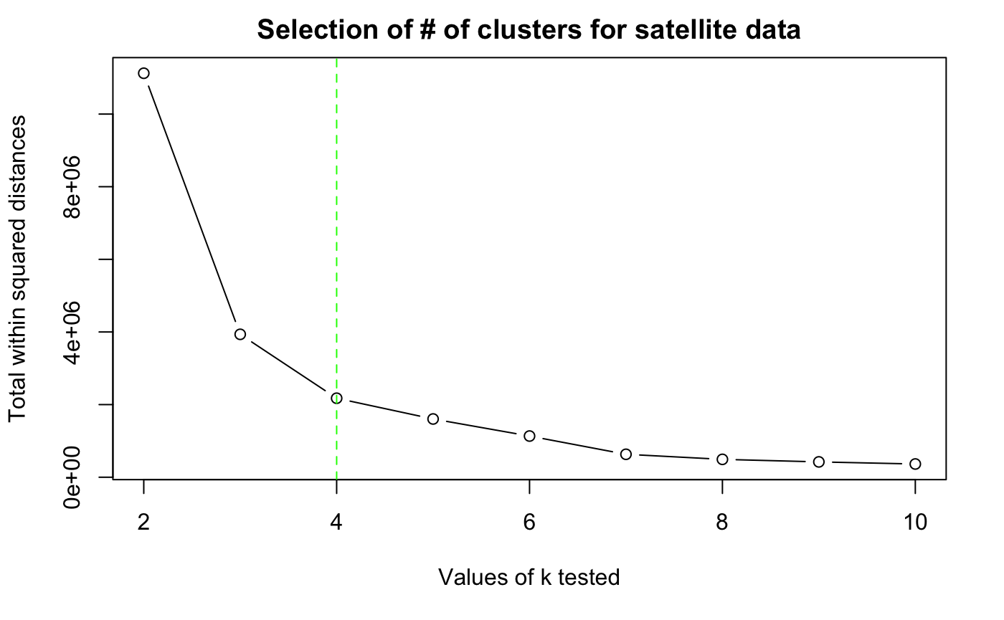
K-means clustering
Notes:
Clustering can be a useful way to visualize and explore unlabeled data. In this case what is unlabelled could be what causes the break each year. The specific technique we used is k-means clustering which relies initially on random clusters and then iteratively reassigns data points to the closest cluster mean point. Looking at the total distances within the clusters, we choose to go with 4 clusters as it still had a significant decrease from 3 clusters. And looking at the clusters themselves with the month displayed through the shape, you can see the red cluster in the upper right is solely April while the others are mixed, so possibly that cluster represents some trigger that only happens in April.

Slide 16
Predictions

Slide 17
Our 2021 prediction vs reality:
May 12th
2:12pm
April 30th
12:50pm

Slide 18
May 8th, 8:09pm
Our 2022 prediction:

Slide 19
Thank you!
We are happy to answer any questions

